Slide 1
SRP/SRM
Unit 1 AV Setup
Notes:
It’s important to have the projector or monitor operating properly.
The following slides will allow you to understand what to adjust with the projector, computer, television or monitor to achieve the best viewing.

Slide 2
Notes:
The white “target” slide provides a series of clues about the pro- jection system. The red outside border should be entirely visible. With HD televisions, this can also identify underscan or overscan issues and there may be a setting that can correct the problem.
The squares on the upper right should be in red, green and blue. If any one of these is black there is a problem with the projector lamp.
The circle should be a circle, the square should be a square and if they are an oval and a rectangle, you may be able to adjust it by changing the refresh rate or resolution of the display, on the computer.

Slide 3
RGB
Red Green Blue
Notes:
This is a second RGB verification. If any of the colors are black, then replace the lamp or projector.

Slide 4
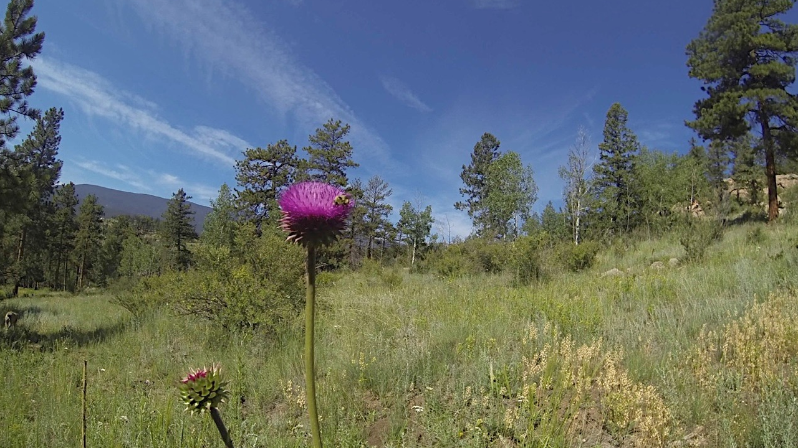
Notes:
Photo test. The purpose is to get another look at the color representation, sharpness and focus.

Slide 5
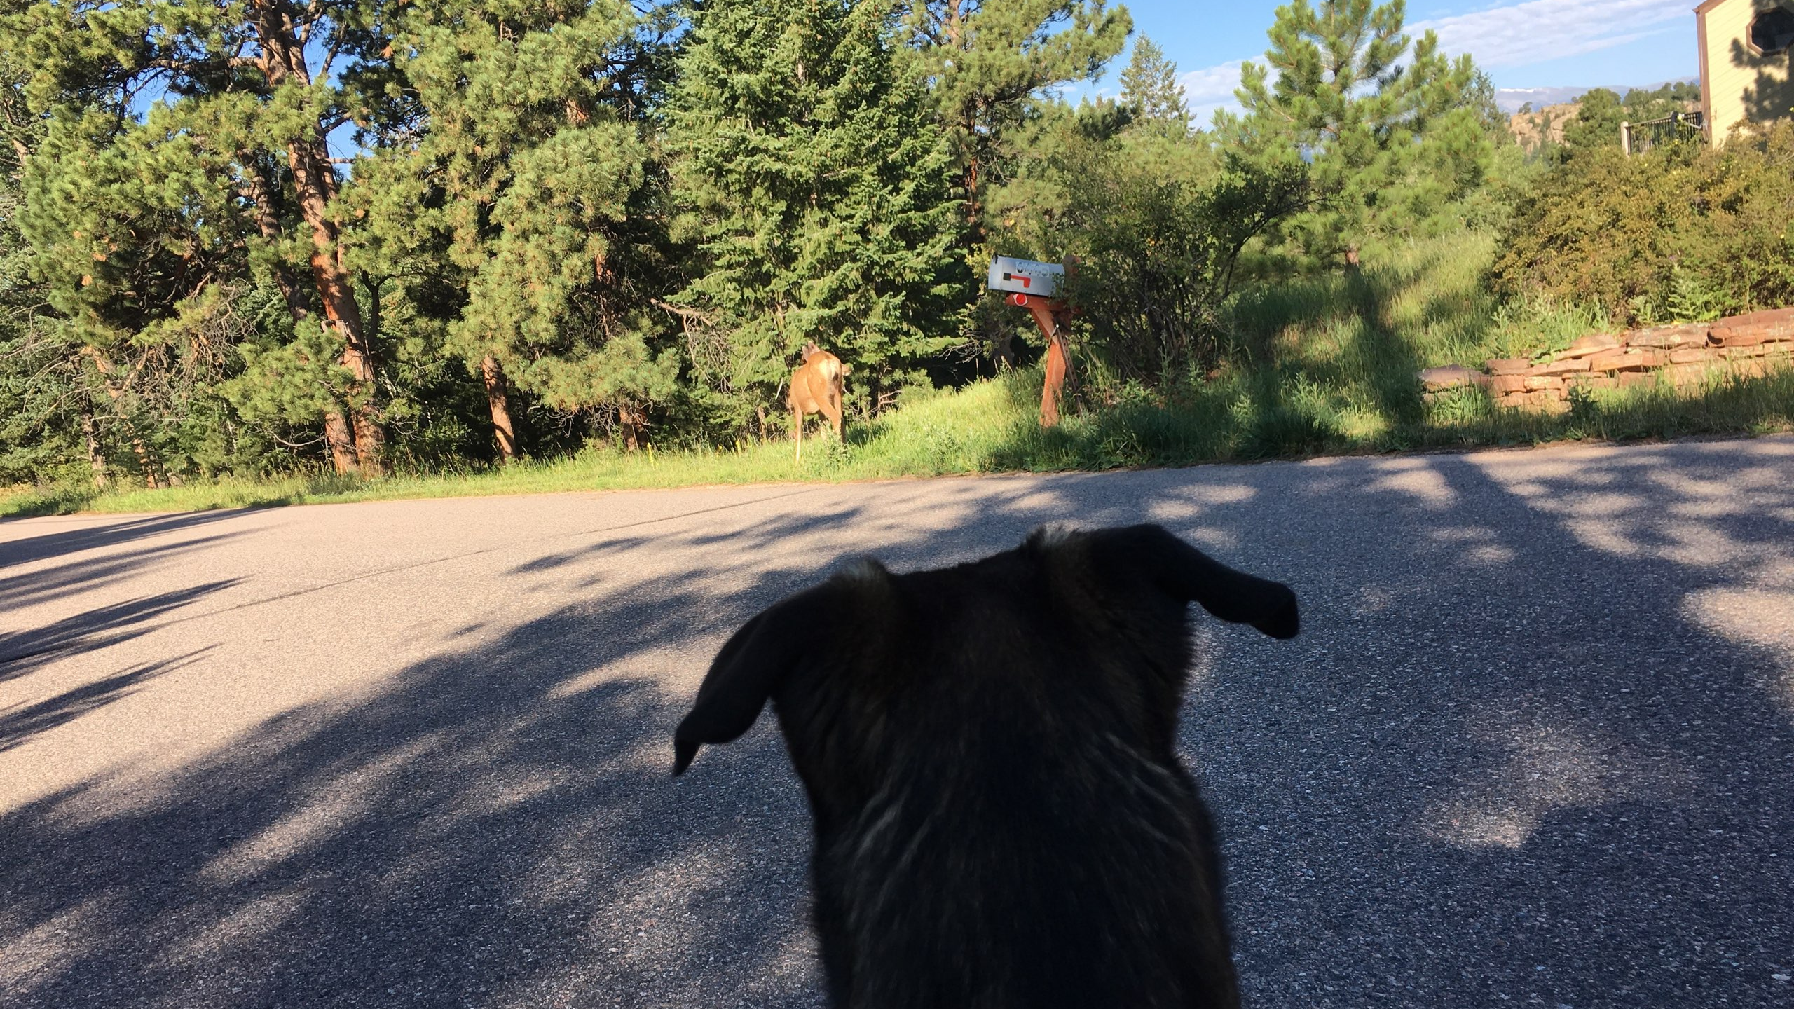

Slide 6
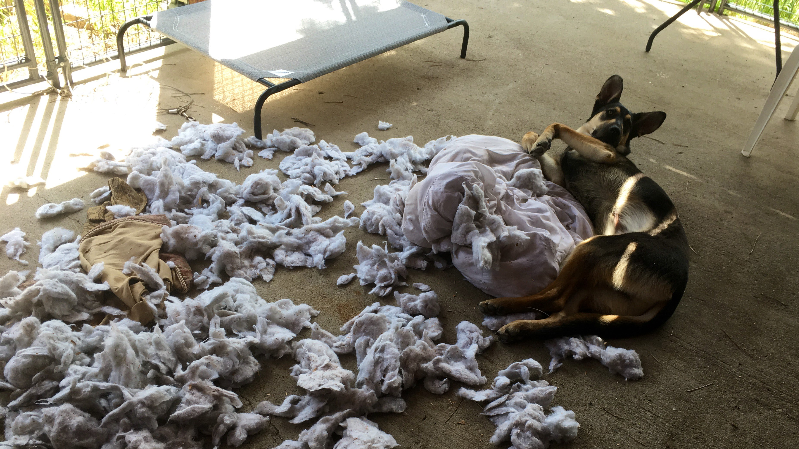

Slide 7
Notes:
One more opportunity, this time in white on black, to verify pro- portions and color. It’s also a good time to adjust the keystone on the projector.

Slide 8
RGB
Red Green Blue

Slide 10
Notes:
The reasoning behind having several photo slides is to give you ample opportunity to spot problems. If you have adequate time, step around the room and see if there are any issues. This also gives you an opportunity to test the range of the remote control or slide advance clicker.

Slide 11
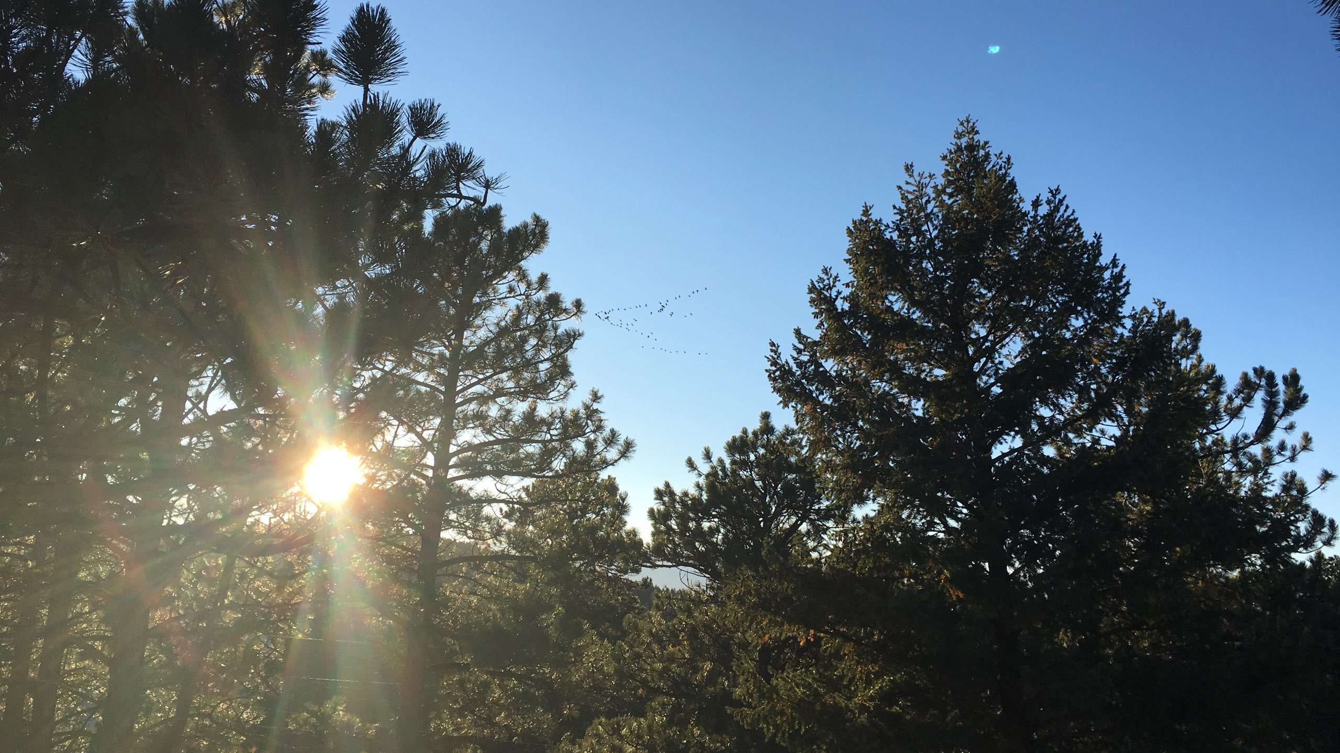
Notes:
The reasoning behind having several photo slides is to give you ample opportunity to spot problems. If you have adequate time, step around the room and see if there are any issues. This also gives you an opportunity to test the range of the remote control or slide advance clicker.

Slide 12
Soundcheck
Left Channel
Notes:
When you have an AV or IT person assisting with the setup, it’s about here when they ask about audio. These slides allow you to test if both channels are working.

Slide 13
Soundcheck
Right Channel
Notes:
For this presentation, don’t worry if you can only hear the left or the right. All audio in this presentation is monophonic. As long as you have one of the two channels you’ll be ok.

Slide 14
Video Check
Notes:
This is a neat snippet from the Aspen PD and Pitkin County Sheriff’s Office in Colorado. If you are training little ones, view this first.

Slide 15
Notes:
This is a neat snippet from the Aspen PD and Pitkin County Sheriff’s Office in Colorado. But it let’s you test your video.

Slide 16
SRP/SRM
End AV Setup
Notes:
End Setup

Slide 17
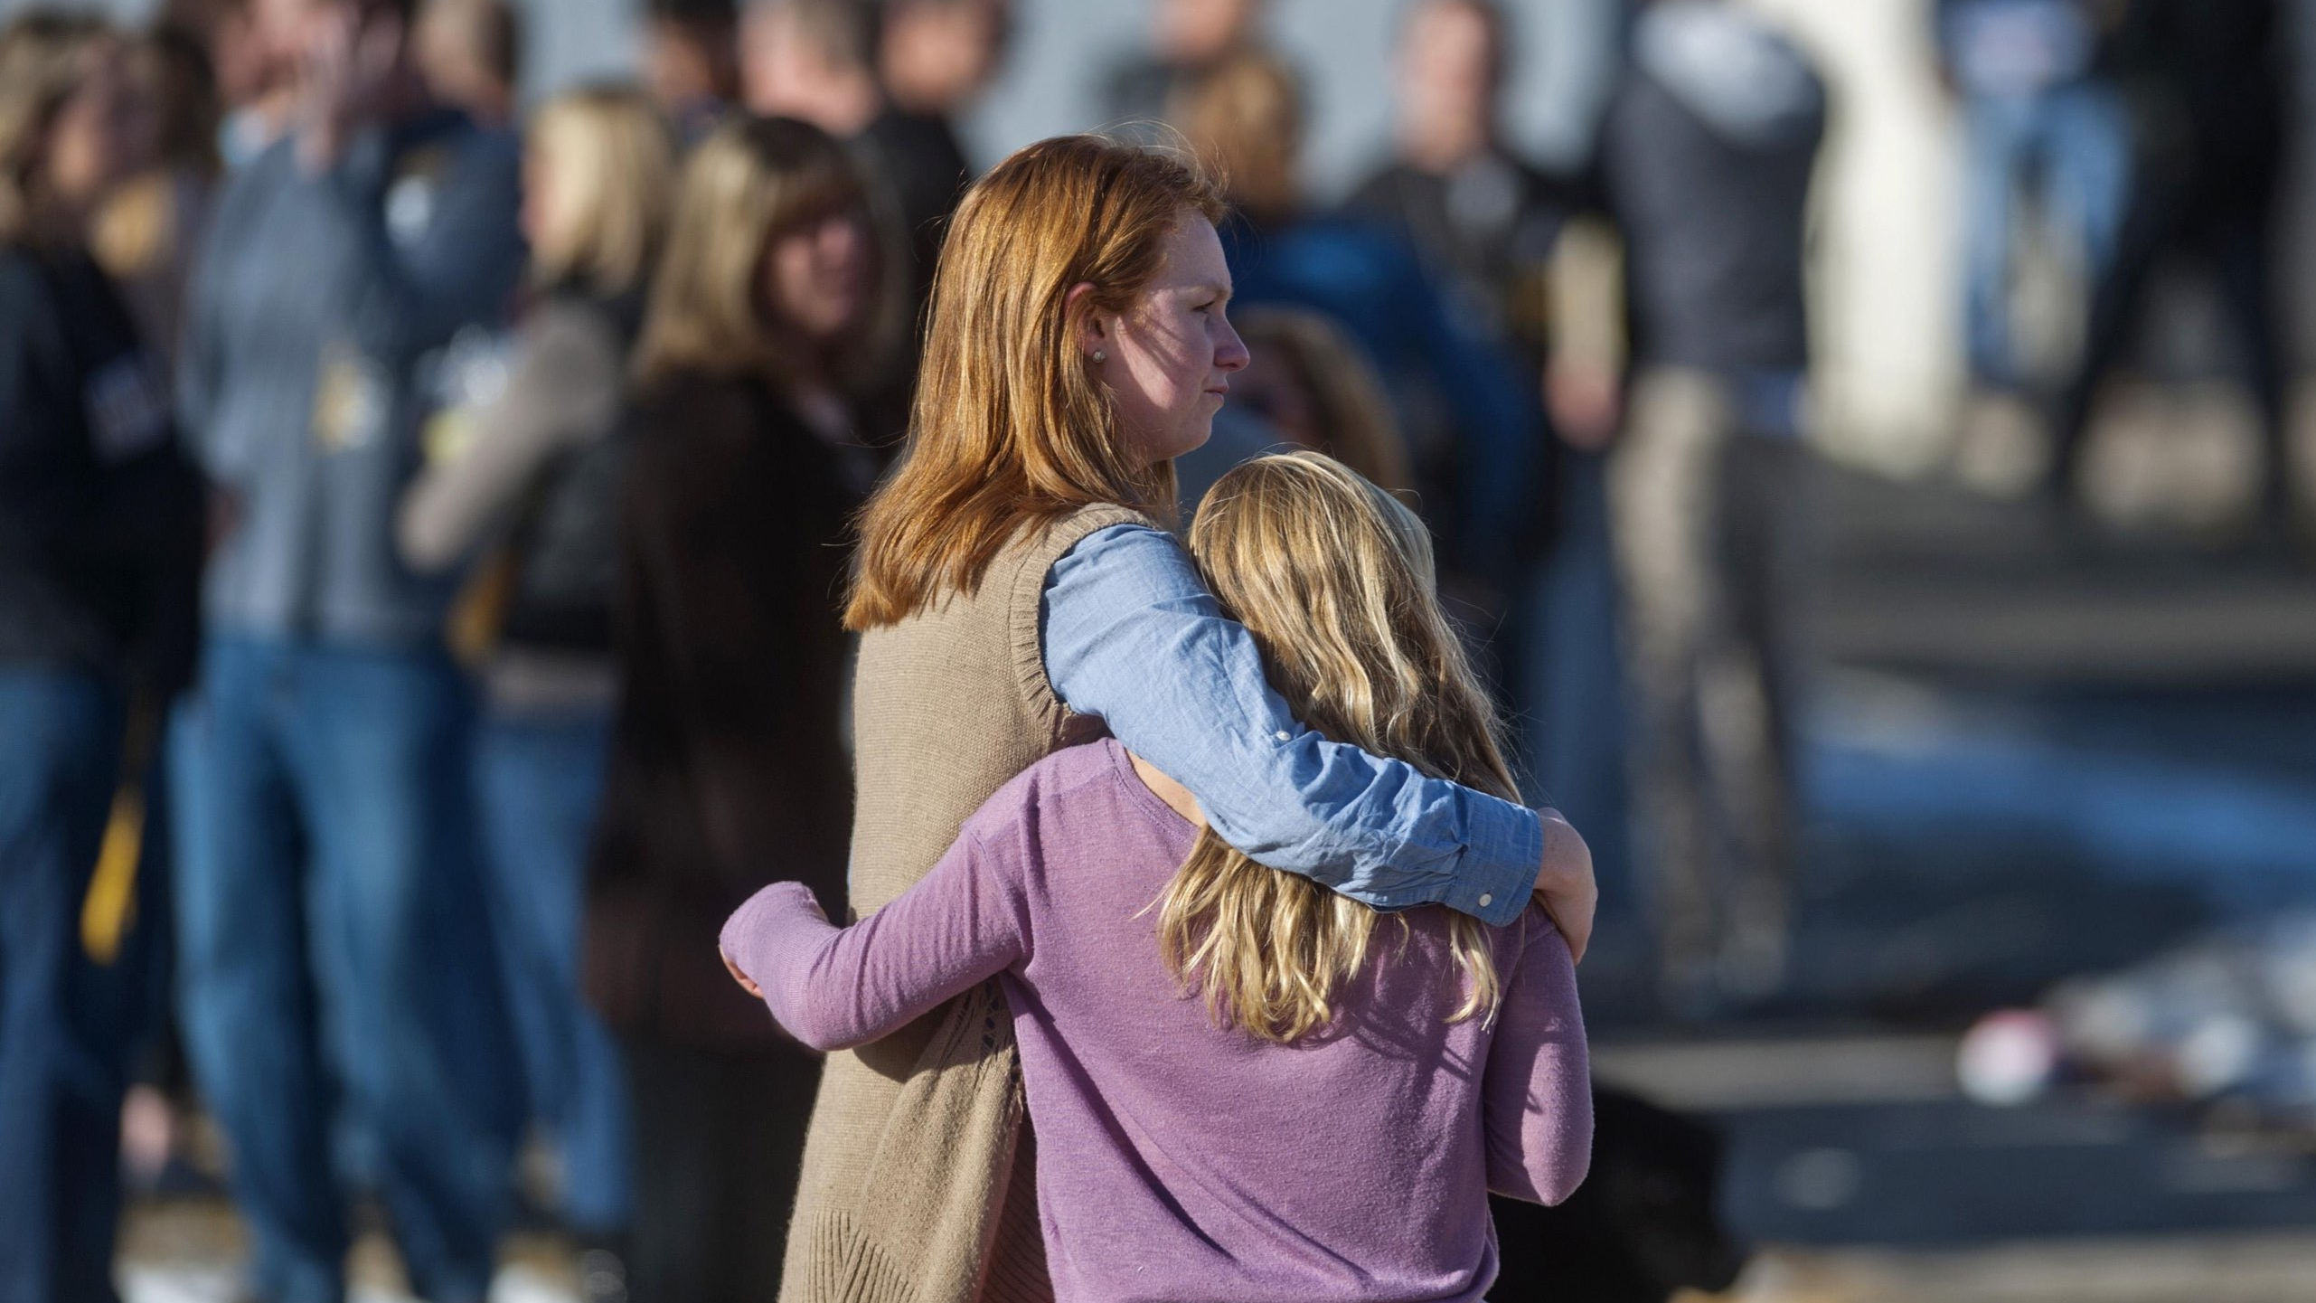
Recovery Starts when the crisis begins
Notes:
Splash slide. This should be the slide that is projected as attendees are settling in before the presentation.

Slide 18
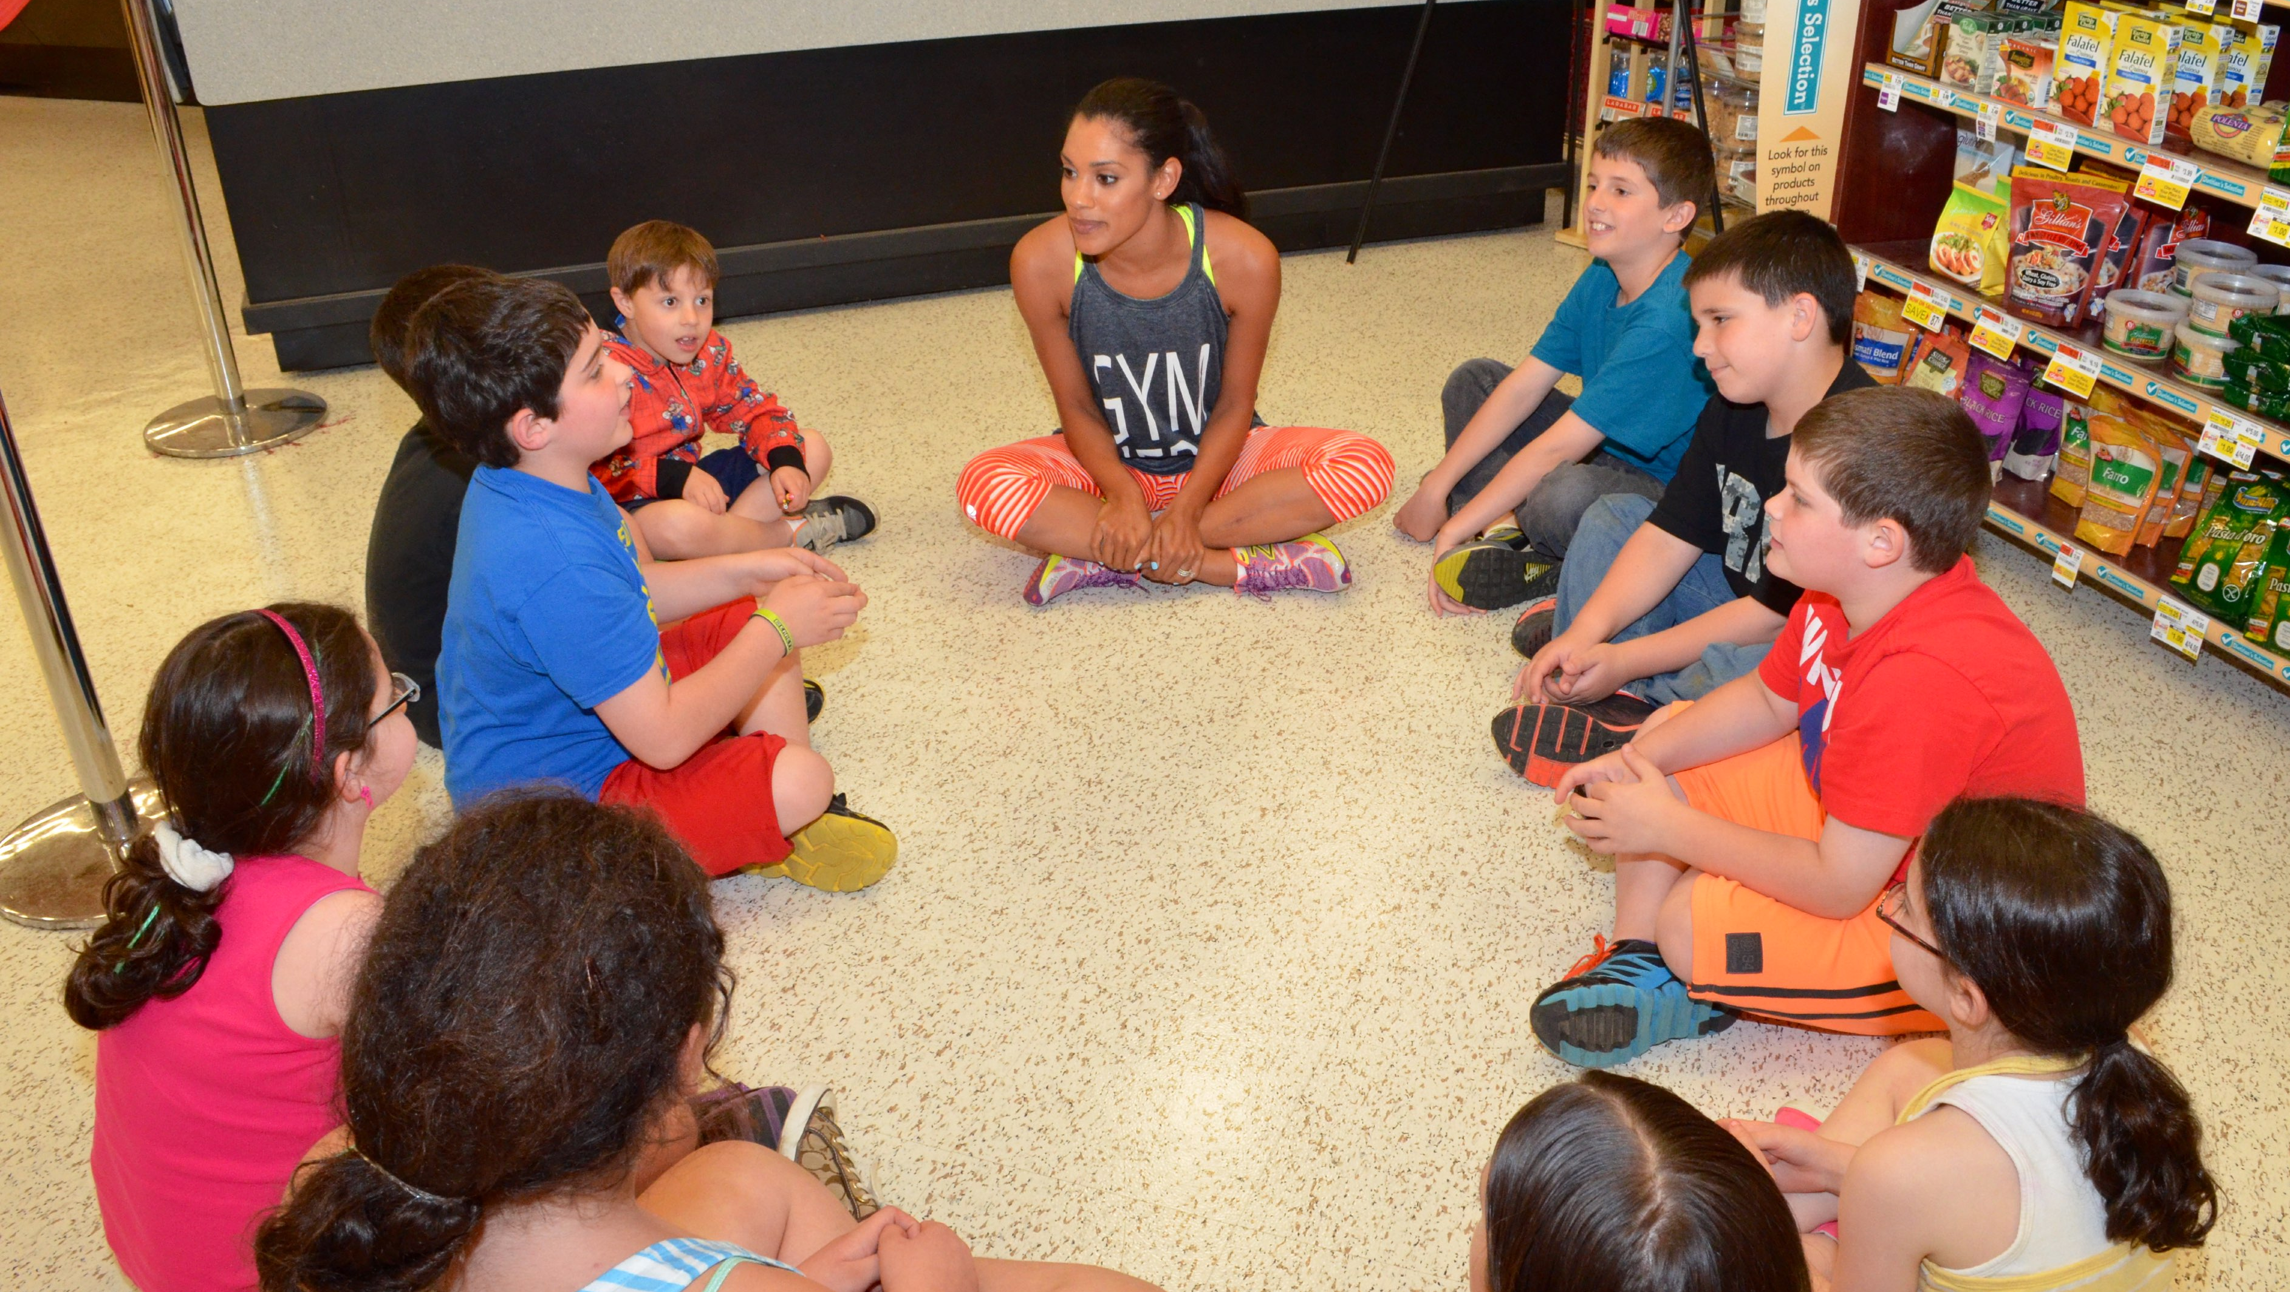
Unit 1
Introductions

Slide 19
Howdy
Notes:
If your audience size is appropriate, Ask for introductions.
Name, job title, and organization.
A brief statement of overall experience with emergency or incident response in schools.
Assigned position(s) in your school Incident Command organization.
What they hope to gain from this course.

Slide 20
Notes:
Start with introductions and expectations.
Your name, job title, and organizations.
A brief statement of your overall experience with emergency or incident response in schools.
Your assigned position(s) in your school Incident Command organization.
What you hope to gain from this course.

Slide 21
Not an Expert
But an Avid student
Notes:
I am not an expert at any of this. But I am an avid student.

Slide 22
Interactive
Notes:
While we are on a structured timeline today, if there is something that you need clarified, or you have questions, please ask. This is your time.

Slide 23
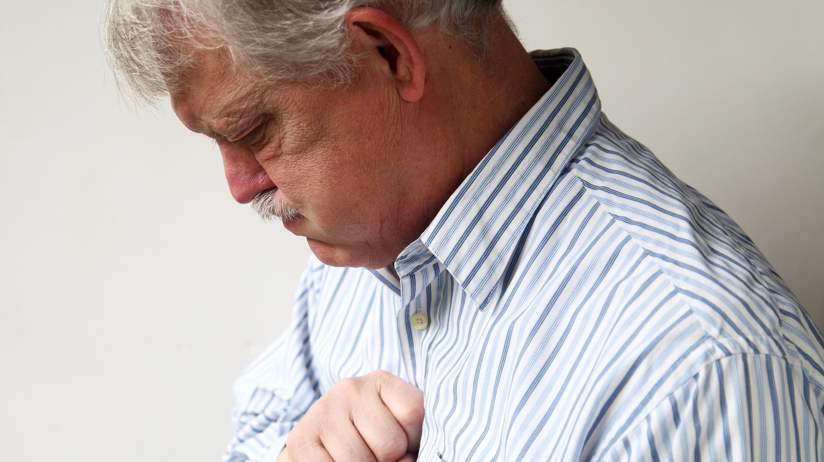
Heartburn
Notes:
If something I say gives you any heartburn, speak out. Like I said. Not an expert, but an avid student. Means that if I’m wrong about something, tell me. There is too much payroll in this room to propagate inaccuracy.

Slide 24
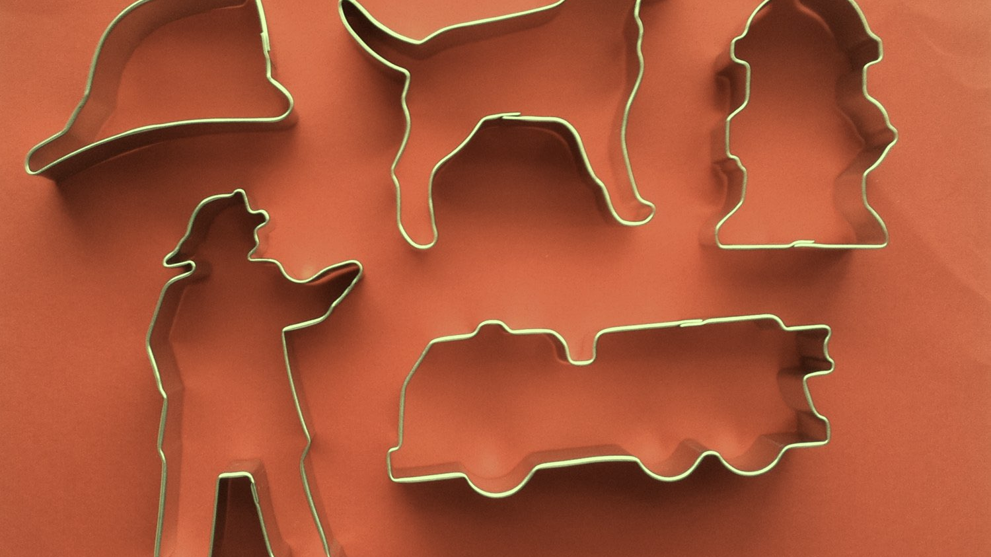
Central Consideration
Notes:
Throughout the day, we also need to recognize that there are no cookie cutter solutions.

Slide 25
Tactics are intel driven
Notes:
So, we want to constantly have these thoughts in mind.
Tactics are intel driven.
So what we plan to do is based on what we know.

Slide 26
Environment dictates tactics
Notes:
But ultimately, the environment dictates our tactics.
So what we do is based on where we are and what is happening around us.

Slide 27
Objectives and outcomes
Notes:
Let’s go through today’s training objectives and desired outcomes.

Slide 28
Definition: TLA
Three Letter Acronym
Notes:
First a quick definition. TLA. Anybody?
<CLICK>
Three letter acronym. We’re going to have a few of those today.

Slide 29
Quick Review Of The SRP
Notes:
We’ll start with the SRP

Slide 30
SRP
Standard Response Protocol
Notes:
The Standard Response Protocol

Slide 31
Classroom Training
Notes:
Then we’ll go through the classroom training of the Standard Response Protocol.

Slide 32
Review NIMS and ICS
Notes:
We’re going to do a quick review on the NIMS and ICS

Slide 33
NIMS
National Incident Management System
Notes:
NIMS - The National Incident Management System. (That’s a FLA... Four letter acronym.)

Slide 34
ICS
Incident Command System
Notes:
ICS - The Incident Command System.

Slide 35
Understand The SRM
Notes:
Then we’ll talk about the SRM

Slide 36
SRM
Standard Reunification Method
Notes:
Then we’ll talk about the Standard Reunification Method.

Slide 37
Understand Roles
Notes:
Understand the roles necessary to perform a reunification.

Slide 38
Case Studies
Notes:
We’re going to go through some case studies.

Slide 39
Take Aways & Evaluation
Notes:
We’ll wrap with a review and evaluations.

Slide 40
JUmpstart Your PLAN
Notes:
If we’ve done our jobs today it should be enough to jumpstart your planning.

Slide 41
Questions, Comments, Heartburn?

